Slide 1

행렬과 벡터 응용
2026 Spring
조상구

Slide 2
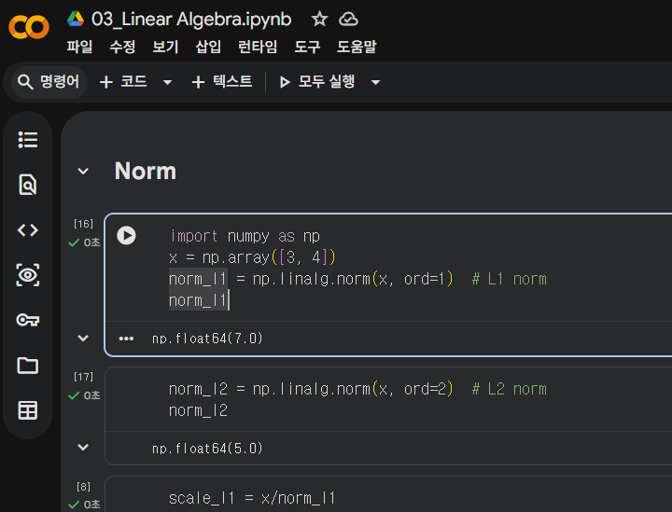
목차
Distance와 Norm
K-nearest neighbor
Supervised Learning
회귀생성(Regression)
Random Forest
Unsupervised Learning
Eigen value & vectors
주성분 분석(Principal Component Analysis)
SVD(Singular Value Decomposition) & Topic Model
Deep Learning
Perceptron
Deep Learning
Convolution Transformation (Image)

Slide 3
Learning Objectives
Preliminary concepts
Vectors
Matrices
Linear Mapping
Norm (L1, L2)
Numpy Applications

Slide 4
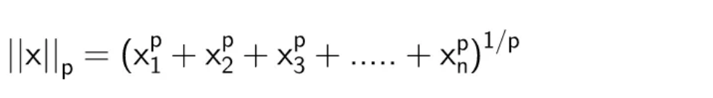
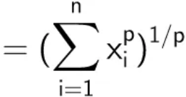
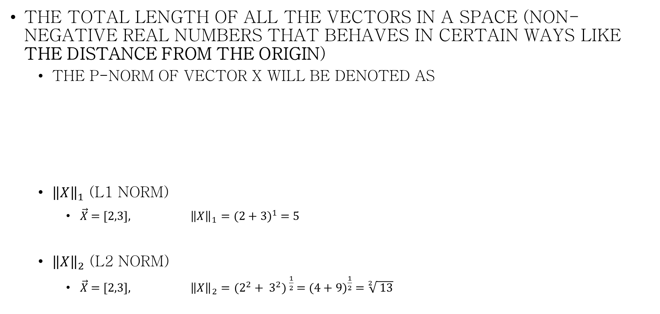
Norm
The total length of all the vectors in a space (non-negative real numbers that behaves in certain ways like the distance from the origin)
The p-norm of vector x will be denoted as
${\left\|X\right\|}_{1}$ (L1 norm)
$\vec{X}$ = [2,3], ${\left\|X\right\|}_{1}={(2+3)}^{1}$ = 5
${\left\|X\right\|}_{2}$ (L2 norm)
$\vec{X}$ = [2,3], ${\left\|X\right\|}_{2}={(2^{2}+ 3^{2})}^{ \frac{1}{2}}$ = ${(4+9)}^{\frac{1}{2}}$ = $\sqrt[2]{ 13}$

Slide 5
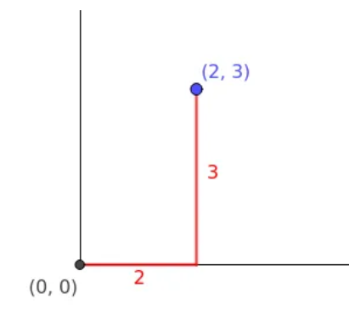
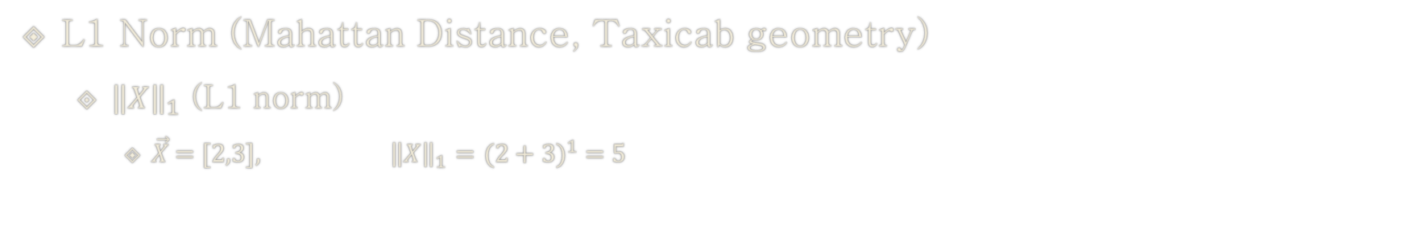
1-Norm
L1 Norm (Mahattan Distance, Taxicab geometry)
${\left\|X\right\|}_{1}$ (L1 norm)
$\vec{X}$ = [2,3], ${\left\|X\right\|}_{1}={(2+3)}^{1}$ = 5
# python code
import numpy as np
x = np.array([2, 3])
norm_l1 = np.linalg.norm(x, ord=1) # L1 norm
norm_l1
# 5.0
x/norm_l1 # scaled by 1-norm
np.square(x/norm_l1)
np.sum(x/norm_l1)
# 1

Slide 6
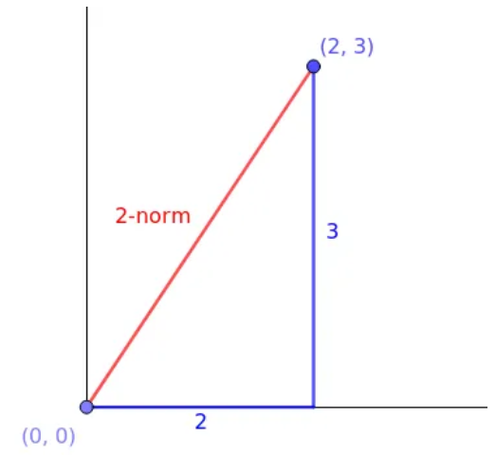
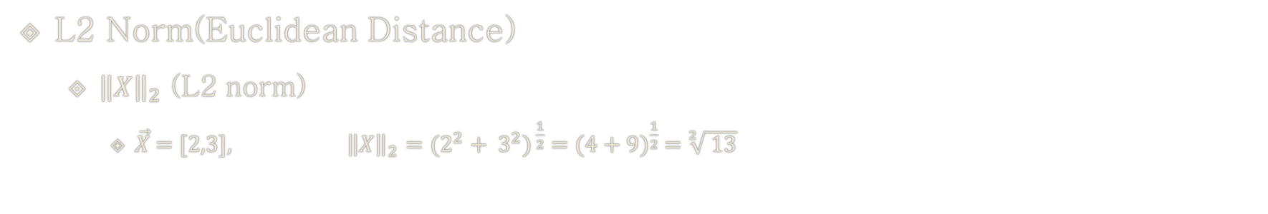
2-Norm
L2 Norm(Euclidean Distance)
${\left\|X\right\|}_{2}$ (L2 norm)
$\vec{X}$ = [2,3], ${\left\|X\right\|}_{2}={(2^{2}+ 3^{2})}^{ \frac{1}{2}}$ = ${(4+9)}^{\frac{1}{2}}$ = $\sqrt[2]{ 13}$
# python code
norm_l2 = np.linalg.norm(x, ord=2) # L2 norm
norm_l2
# 3.605551275463989
x/norm_l2 # scaled by 2-norm
np.square(x/norm_l2)
np.square(x/norm_l2).sum()
# 1

Slide 7

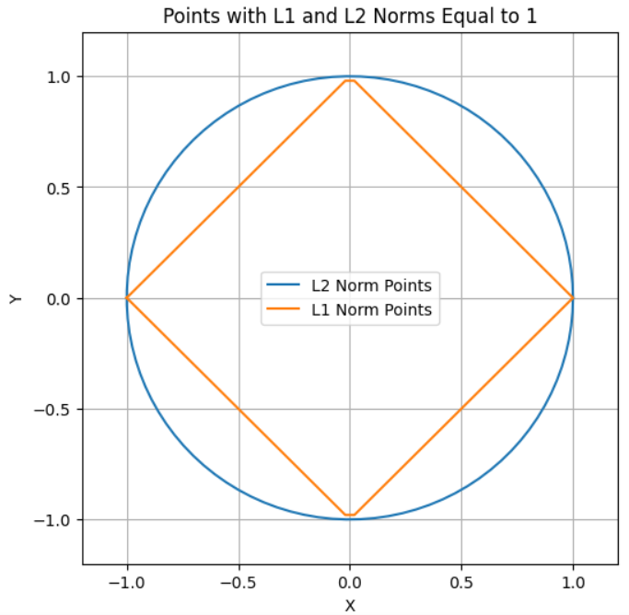

Lasso, Ridge Penalty in machine learning
Lasso
import numpy as np
import matplotlib.pyplot as plt
# Generate values for x
x = np.linspace(-1, 1, 400)
# Calculate corresponding values for y
y_pos = 1 - np.abs(x); y_neg = -1 + np.abs(x)
# Plot the curve where |x + y| = 1
plt.plot(x, y_pos, label='|x + y| = 1')
plt.plot(x, y_neg)
# Set axis labels
plt.xlabel('X'); plt.ylabel('Y')
# Add a legend
plt.legend()
plt.title('Curve where |x + y| = 1')
plt.grid(True)
plt.axhline(0, color='black',linewidth=0.5)
plt.axvline(0, color='black',linewidth=0.5)
plt.show()
Ridge

Slide 8
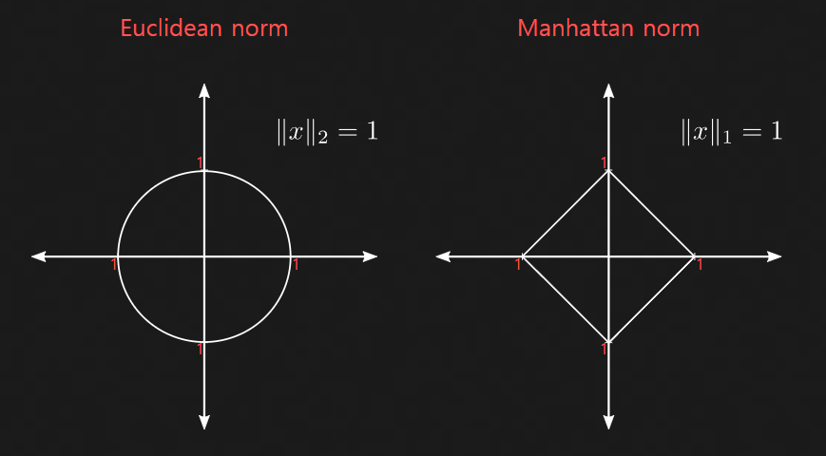
Vector norms
norm or the length of a vector is the distance between its “origin” and its “end”.

Slide 9
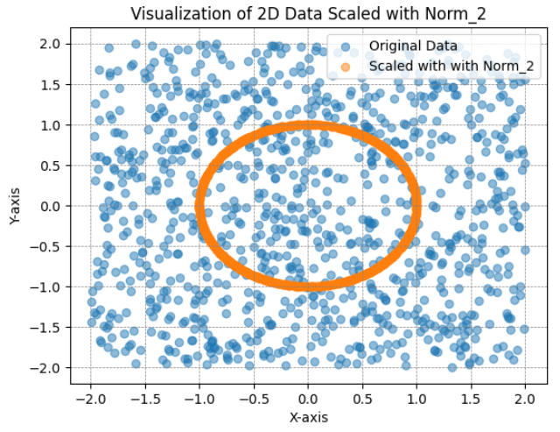
Python code
import numpy as np
import matplotlib.pyplot as plt
def visualize_l1_norm(data, norm):
# Calculate L1 norms for each data point
l1_norms = np.linalg.norm(data, ord=norm, axis=1)
# Scale data based on L1 norms
scaled_data = data / l1_norms[:, np.newaxis]
# Plotting
plt.scatter(data[:, 0], data[:, 1], label='Original Data', alpha=0.5)
plt.scatter(scaled_data[:, 0], scaled_data[:, 1],
label=f'Scaled with with Norm_{norm}', alpha=0.5)
plt.axhline(0); plt.axvline(0)
plt.grid(color='gray', linestyle='--', linewidth=0.5)
plt.title(f'Visualization of 2D Data Scaled with Norm_{norm}')
plt.xlabel('X-axis'); plt.ylabel('Y-axis')
plt.legend()
plt.show()
# Generate random 2D data
random_data = np.random.rand(1000, 2) * 4 - 2 # Values between -2 and 2 for both dimensions
# Visualize the data scaled with L1 norm
visualize_l1_norm(random_data, norm = 2) # Eucledean Norm (L2 norm)
→ It’s your turn to try L1 norm

Slide 10
Learning Objectives
Preliminary concepts
Vectors
Matrices
Linear Mapping
Norm (L1, L2)
Numpy Applications

Slide 11
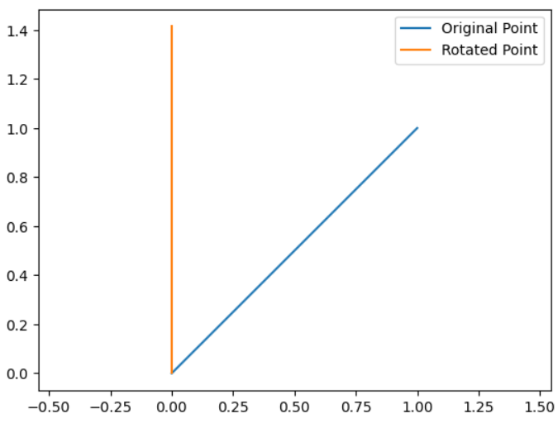
Geometry(1/2)
1. Transformation Matrices (2D Rotation)
import numpy as np
import matplotlib.pyplot as plt
# Define a 2D point
point = np.array([1, 1])
# Define a 2D rotation matrix
theta = np.pi / 4 # 45 degrees
rotation_matrix = np.array([[np.cos(theta), -np.sin(theta)],
[np.sin(theta), np.cos(theta)]])
# Apply rotation to the point
rotated_point = np.dot(rotation_matrix, point)
# Plot the original and rotated points
plt.plot([0, point[0]], [0, point[1]], label='Original Point')
plt.plot([0, rotated_point[0]], [0, rotated_point[1]], label='Rotated Point')
plt.legend()
plt.axis('equal')
plt.show()

Slide 12
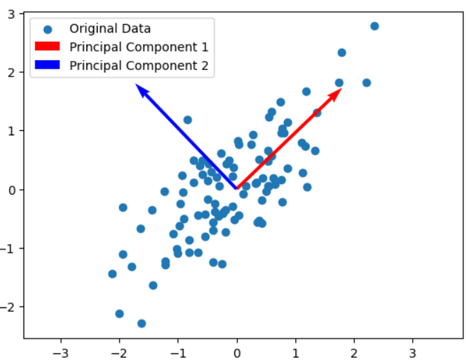
Geometry(2/2)
2. Eigenvalues and Eigenvectors (Principal Component Analysis - PCA):
import numpy as np
from sklearn.decomposition import PCA
import matplotlib.pyplot as plt
# Generate 2D data
data = np.random.multivariate_normal(mean=[0, 0], cov=[[1, 0.8], [0.8, 1]], size=100)
# Apply PCA
pca = PCA()
pca.fit(data)
# Plot the original data and principal components
plt.scatter(data[:, 0], data[:, 1], label='Original Data')
plt.quiver(0, 0, pca.components_[0, 0], pca.components_[0, 1], scale=3, color='r', label='Principal Component 1')
plt.quiver(0, 0, pca.components_[1, 0], pca.components_[1, 1], scale=3, color='b', label='Principal Component 2')
plt.legend()
plt.axis('equal')

Slide 13
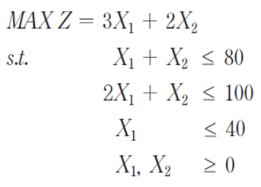
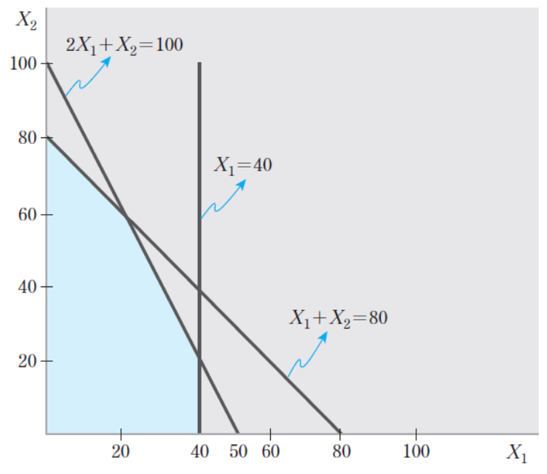
Optimization(1/2)
1. Linear Programing :
from scipy.optimize import linprog
# Objective function coefficients
c = [-3, -2] # Minimize -3x1 - 2x2 is equivalent to maximizing 3x1 + 2x2
# Inequality constraints matrix
A = [[1, 1], [2, 1], [-1, 0]] # Note the change in the third constraint
# Inequality constraints vector
b = [100, 100, -40]
# Bounds for variables
x0_bounds = (0, None)
x1_bounds = (0, None)
# Solve linear programming problem
result = linprog(c, A_ub=A, b_ub=b, bounds=[x0_bounds, x1_bounds], method='highs')
# Display the results
# Negate the result because linprog minimizes by default
print('Optimal value (max z):', -result.fun)
print('Optimal point (x1, x2):', result.x)

Slide 14
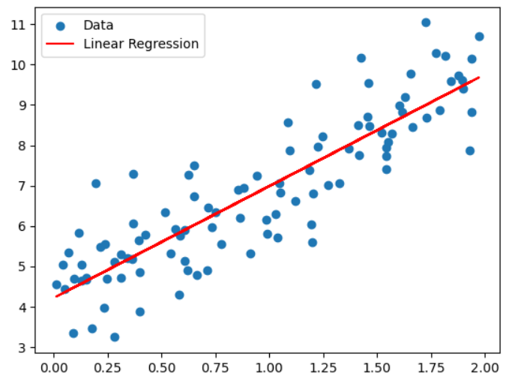
Optimization(2/2)
2. Least Squares Regression:
import numpy as np
import matplotlib.pyplot as plt
# Generate synthetic data
np.random.seed(42)
X = 2 * np.random.rand(100, 1)
y = 4 + 3 * X + np.random.randn(100, 1)
# Perform linear regression
X_b = np.c_[np.ones((100, 1)), X] # add x0 = 1 to each instance
theta_best = np.linalg.inv(X_b.T.dot(X_b)).dot(X_b.T).dot(y)
# Plot the data and regression line
plt.scatter(X, y, label='Data')
plt.plot(X, X_b.dot(theta_best), color='red', label='Linear Regression')
plt.legend()

Slide 15
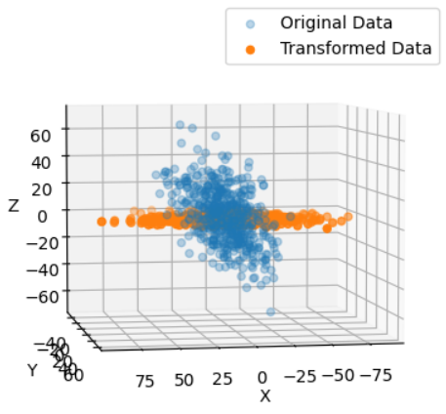
Machine Learning(1/2)
1. Principal Component Analysis(PCA):
import numpy as np
import matplotlib.pyplot as plt
from mpl_toolkits.mplot3d import Axes3D # Import necessary module for 3D projection
from sklearn.decomposition import PCA # Generate 3D data
data = np.random.multivariate_normal(mean=[0, 0, 0],
cov=[[1, 0.8, 0.5], [0.8, 1, 0.3], [0.5, 0.3, 1]],
size=500)*20
# Apply PCA
pca = PCA(n_components=2)
transformed_data = pca.fit_transform(data) # Plot the original and transformed data in 3D
fig = plt.figure()
ax = fig.add_subplot(111, projection='3d')
ax.scatter(data[:, 0], data[:, 1], data[:, 2], label='Original Data', alpha = 0.3)
ax.scatter(transformed_data[:, 0], transformed_data[:, 1], np.zeros_like(transformed_data[:, 1]), label='Transformed Data',) ax.set_xlabel('X’); ax.set_ylabel('Y’); ax.set_zlabel('Z')
ax.legend()
# Adjust the viewing angle
ax.view_init(elev=5, azim=80) # Set the elevation and azimuth angles
plt.show()

Slide 16
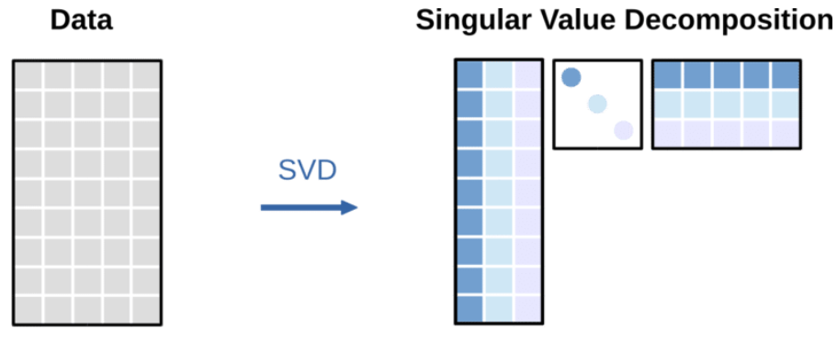
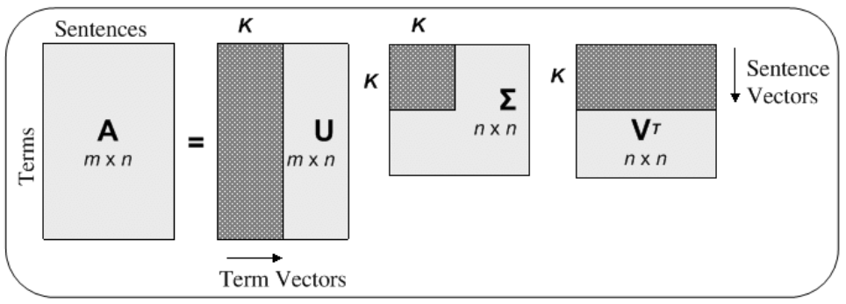
Machine Learning(2/2)
2. Singular Value Decomposition (SVD):

Slide 17
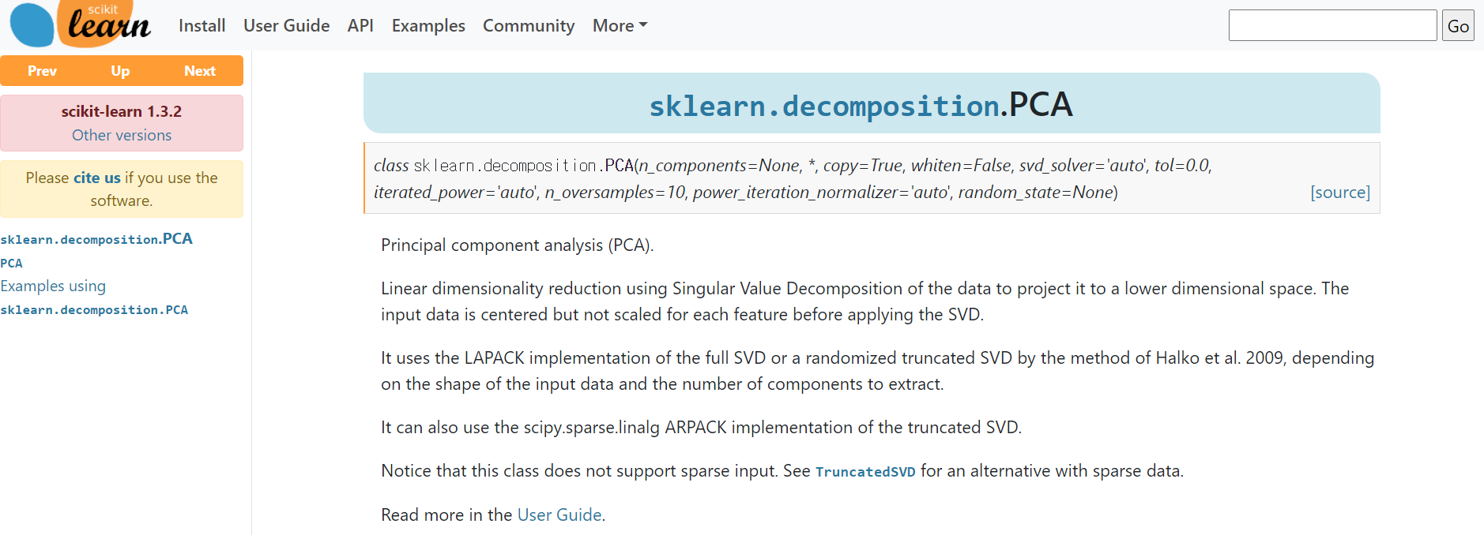
Machine Learning(2/2)

Slide 18
Machine Learning(2/2)
import numpy as np
# Generate a matrix
A = np.random.rand(3, 3)
# Perform SVD
U, S, Vt = np.linalg.svd(A, full_matrices=False)
# Reconstruct the original matrix
A_reconstructed = U @ np.diag(S) @ Vt
print("Original Matrix:")
print(A)
print("\nReconstructed Matrix:")
print(A_reconstructed)
Original Matrix:
[[0.40895294 0.17329432 0.15643704]
[0.2502429 0.54922666 0.71459592]
[0.66019738 0.2799339 0.95486528]]
Reconstructed Matrix:
[[0.40895294 0.17329432 0.15643704]
[0.2502429 0.54922666 0.71459592]
[0.66019738 0.2799339 0.95486528]]

Slide 19
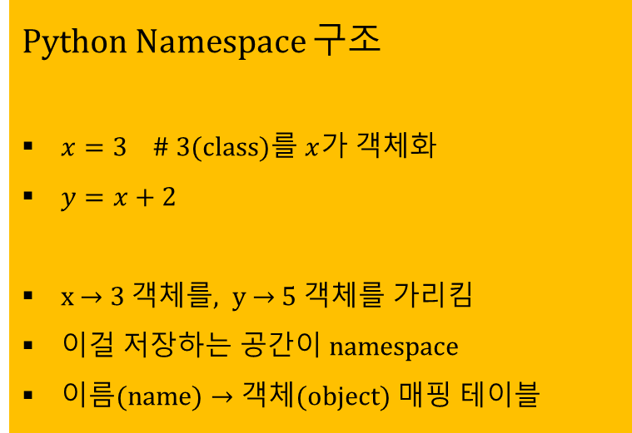
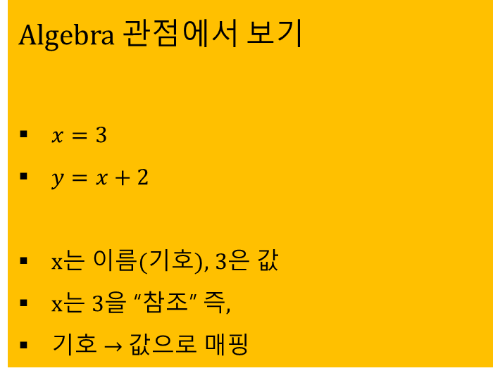
대수(algebra)
Algebra는 기호(symbol) ↔ 값(value)의 관계를 다루고,
Python namespace는 이름(name) ↔ 객체(object)의 매핑을 관리
Algebra 관점에서 보기
$x=3$
$y=x+2$
x는 이름(기호), 3은 값
x는 3을 “참조” 즉,
기호 → 값으로 매핑
Python Namespace 구조
$x=3$ # 3(class)를 $x$가 객체화
$y=x+2$
x → 3 객체를, y → 5 객체를 가리킴
이걸 저장하는 공간이 namespace
이름(name) → 객체(object) 매핑 테이블

Slide 20
목차
Numpy
선형변환(Linear Transformation)
주성분 분석(Principal Component Analysis)

Slide 21
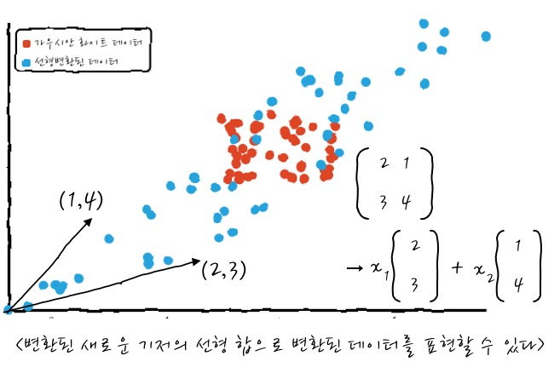
주성분(Principal component)

Slide 22
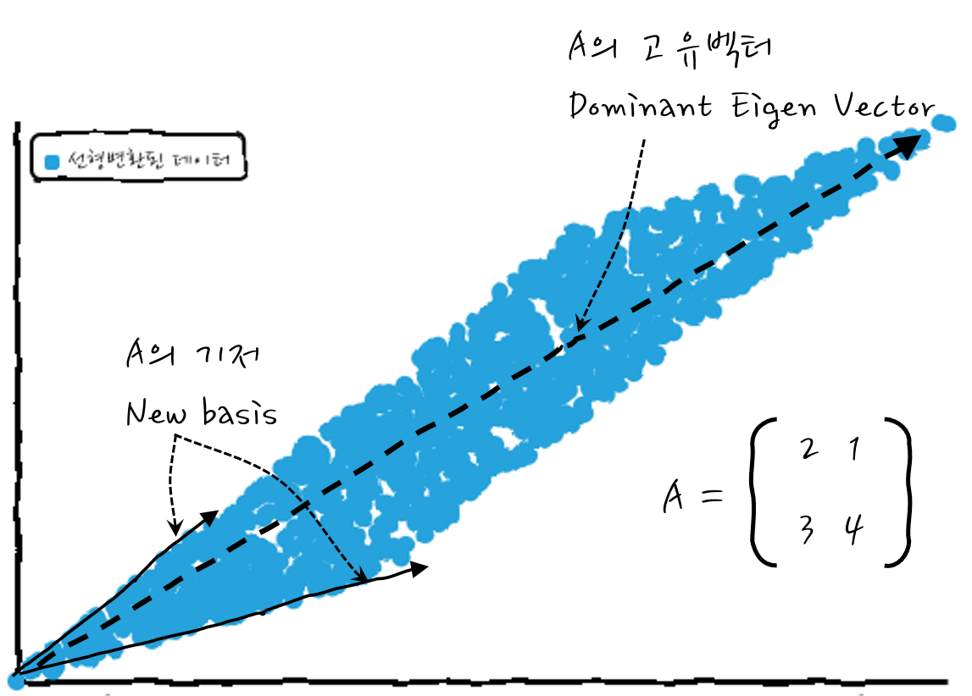
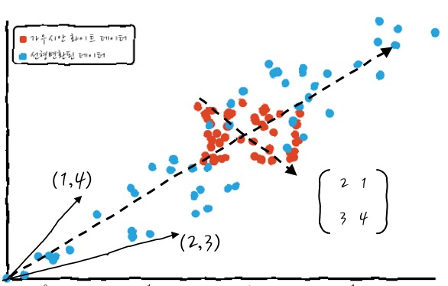
행렬변환에 의한 기저좌표의 변화

Slide 23
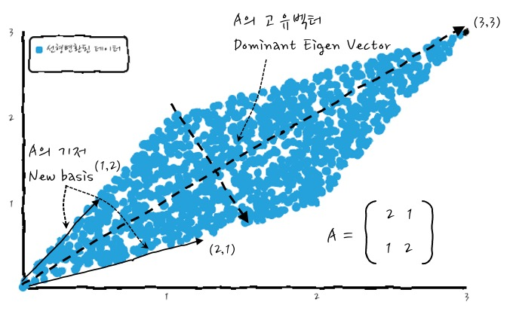
주성분분석

Slide 24
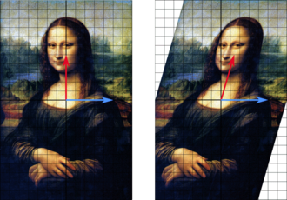
Eigenvalues_and_eigenvectors

